Slide 1
RPO AND AMAZON HIRING ECOSYSTEM

Slide 2
What is Recruitment Process Outsourcing?

Slide 3
Recruitment Process Outsourcing
RPO is a strategic partnership where Amazon brings in a specialized firm to manage all or part of its hiring process.
RPO follows the "One Team" approach, where the recruiters belong to an RPO partner, they work inside Amazon’s systems, follow Amazon’s culture, and represent the Amazon brand.
Result
Scenario
RPO
Amazon hires faster, gets better-quality candidates, and scales recruitment smoothly without overloading internal HR.
Amazon faces a hiring surge with thousands of applications overwhelming its HR team.
The RPO team does resume screening, pre-qualification, and compliance checks to filter suitable candidates efficiently.

Slide 4
Why Amazon uses RPO?

Slide 5

Scalability
Speed:
Candidate Experience:
Focus:
Rapidly hiring thousands for peak seasons (like Prime Day).
Specialized teams focused solely on filling specific roles quickly.
Dedicated recruiters ensure every applicant gets a response.
Allows internal HR to focus on long-term corporate strategy.

Slide 6
RPO JOURNEY
Queue Alignment: Ensuring the agent reviews and proceeds with the queue assigned to them.
Validation: Check if the candidate portfolio (qualification, visa, scores, etc.) matches the job requirements.
Screening: First-level check to assess their basic qualifications.
Candidate progression: Advancing the candidate’s profile to the next level based on eligibility and process requirements.

Slide 7
AMAZON HIRING ECOSYSTEM

Slide 8
HOW DOES AMAZON HIRE THE BEST CANDIDATES?

Slide 9
The “Bar Raiser” Philosophy
The Mission:
Amazon doesn't just hire to fill a gap; they hire to raise the bar.
The Rule:
A new hire should be better than 50% of the current employees in that role.
Example:
Like a Professional Sports Team; you don't just need a player; you need someone who makes the whole team more competitive than they were yesterday.

Slide 10

STAR Interview Method
Situation
Describe the situation or challenge you faced
Action
Describe how you accomplished the task
Task
Explain the task and your responsibility
Result
Share the outcome and impact of your actions

Slide 11
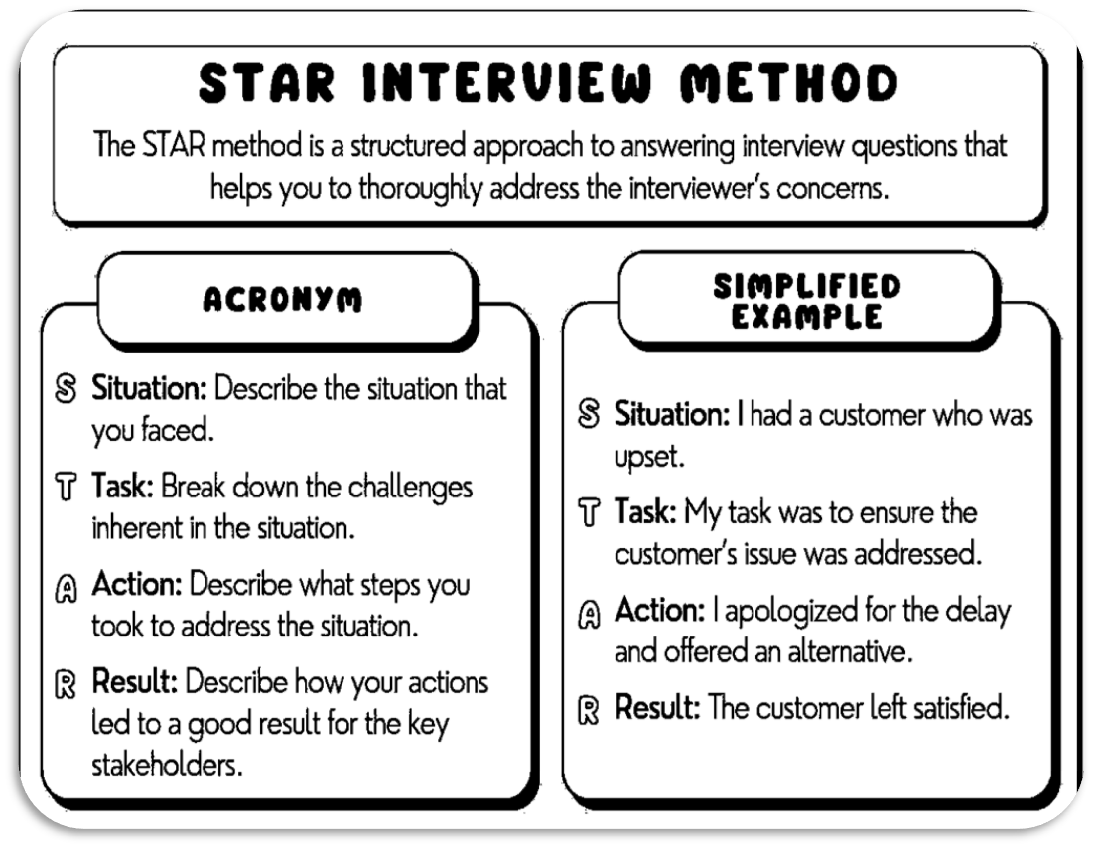
Example:

Slide 12
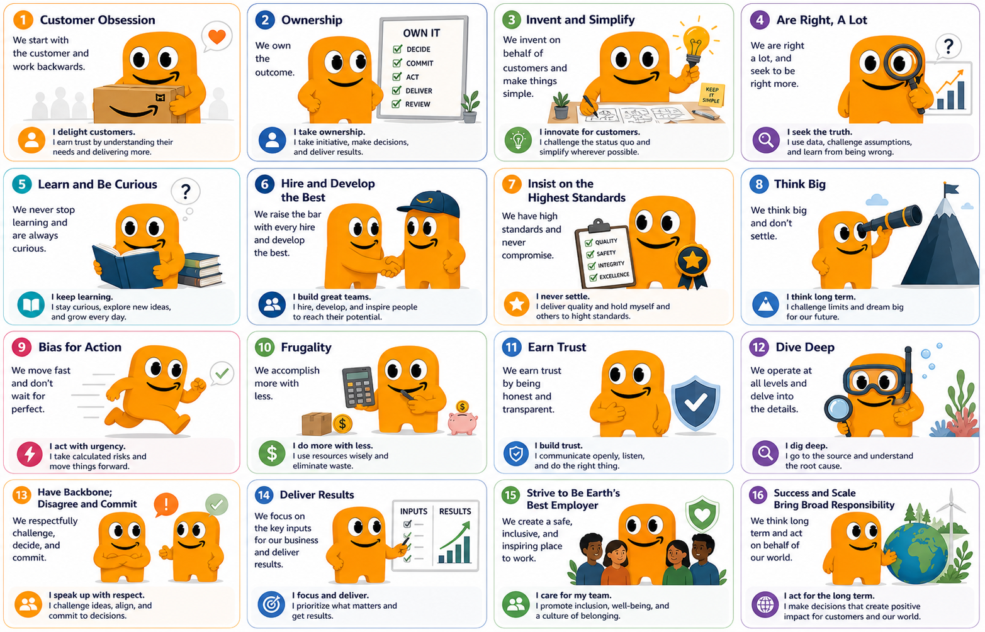
Amazon’s 16 Leadership Principles
These 16 principles are the "DNA" of Amazon. Every interview question is designed to test your alignment with specific principles.

Slide 13
THE COMPLETE AMAZON EXPERIENCE
  Seamless Experience: You are part of the Amazon family from Day 1.
  Unified Standards: RPO partners follow the exact same "Bar Raising" standards as Amazon.
  Professionalism: Your RPO recruiter is your dedicated guide through the complex hiring maze.

Slide 14
THANK YOU
FOR YOUR ATTENTION!

